Slide 1
New Probation Process
In Redwood UI

Slide 2

Employee Related Tasks

Slide 3
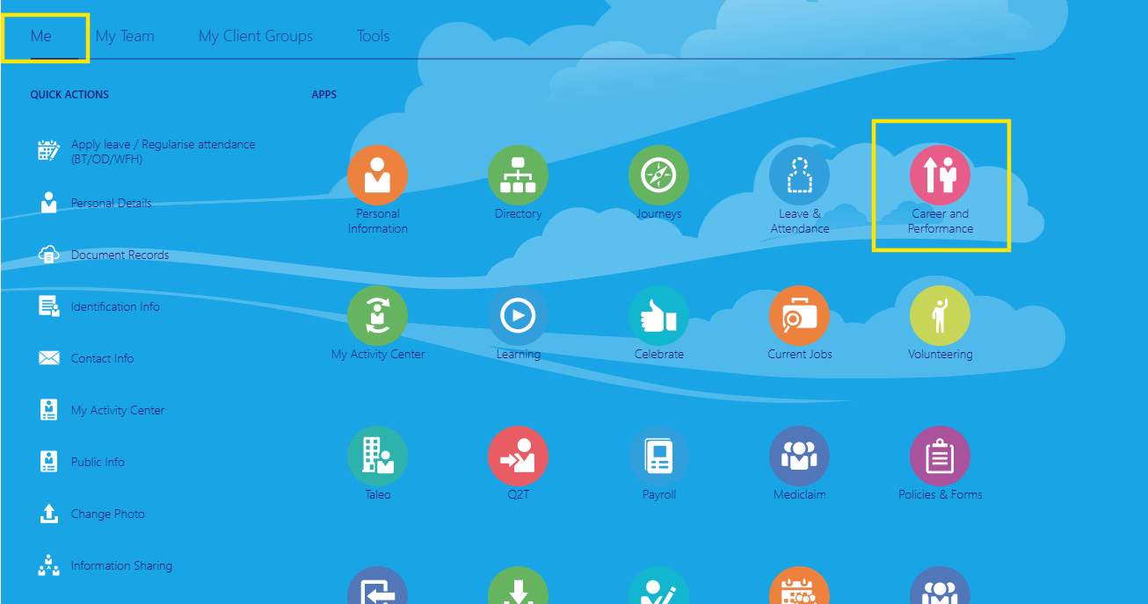
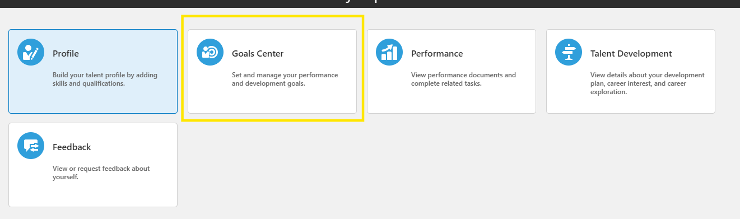
At the start of the Probation employee will go to the ‘Goal Centre’ to set probation goals.
Me > Career and Performance > Goal Centre

Slide 4
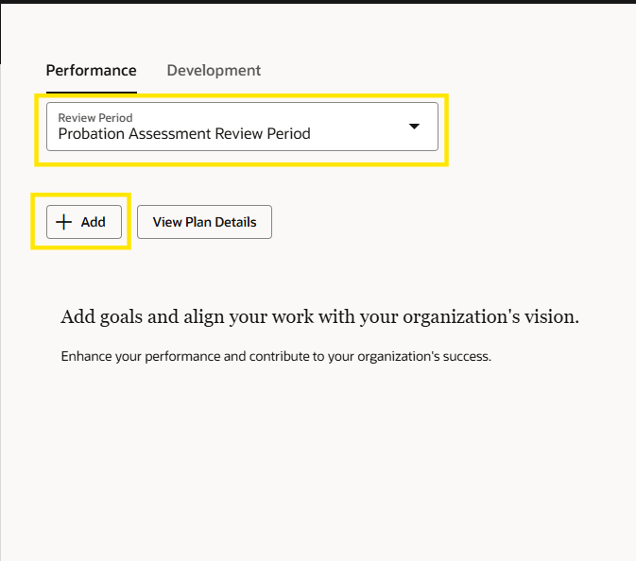
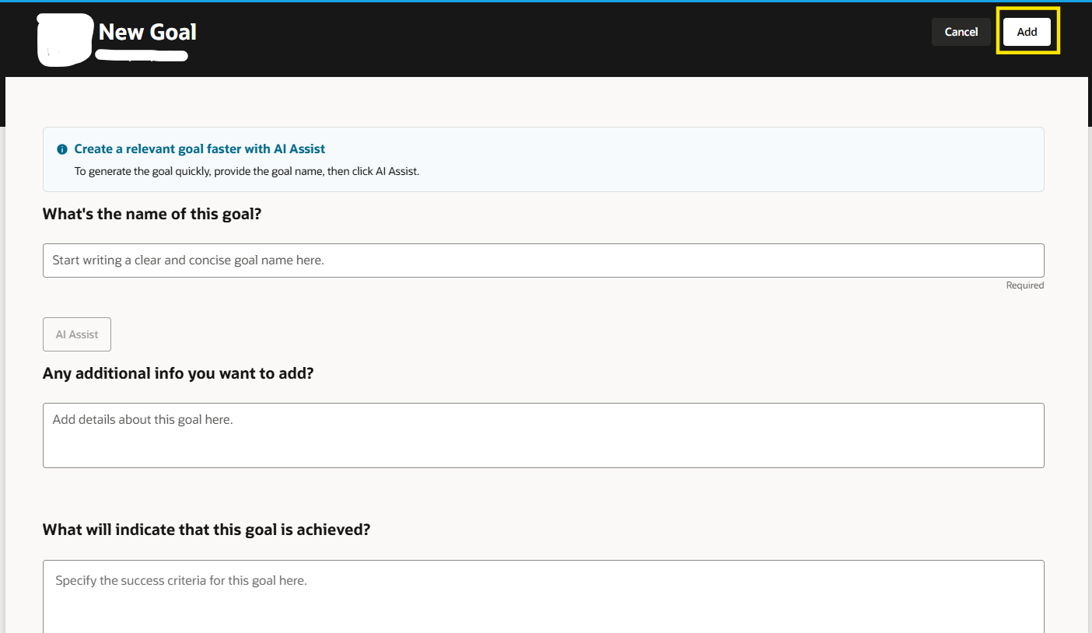
Select the Probation Assessment Review Period and click ‘Add’ to add goals.

Slide 5
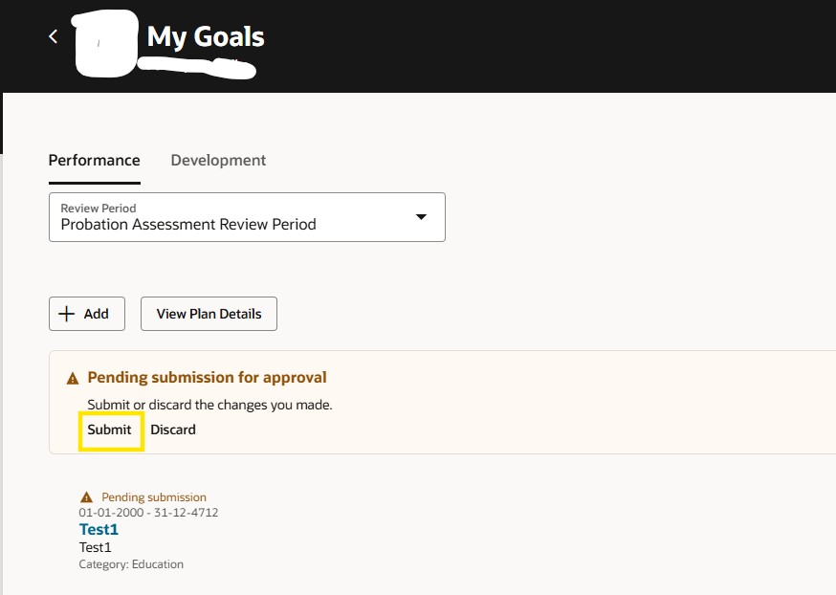
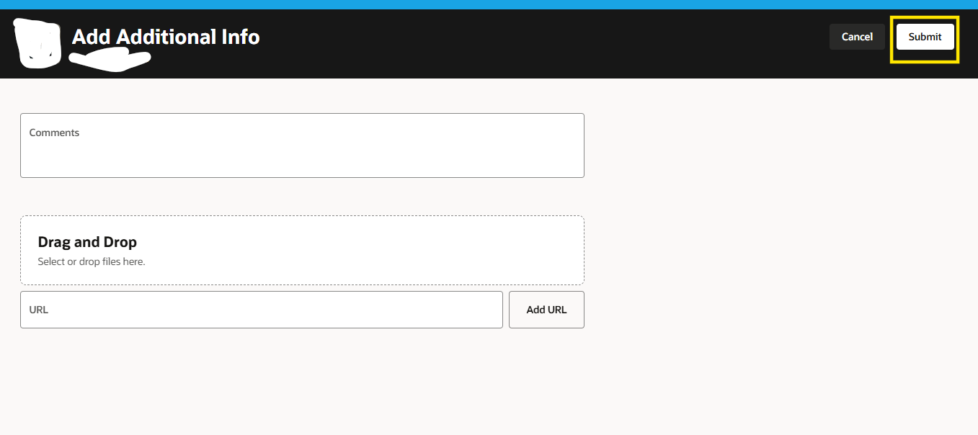
Add probation goals and submit for manager’s approval

Slide 6
Manager Related Tasks

Slide 7
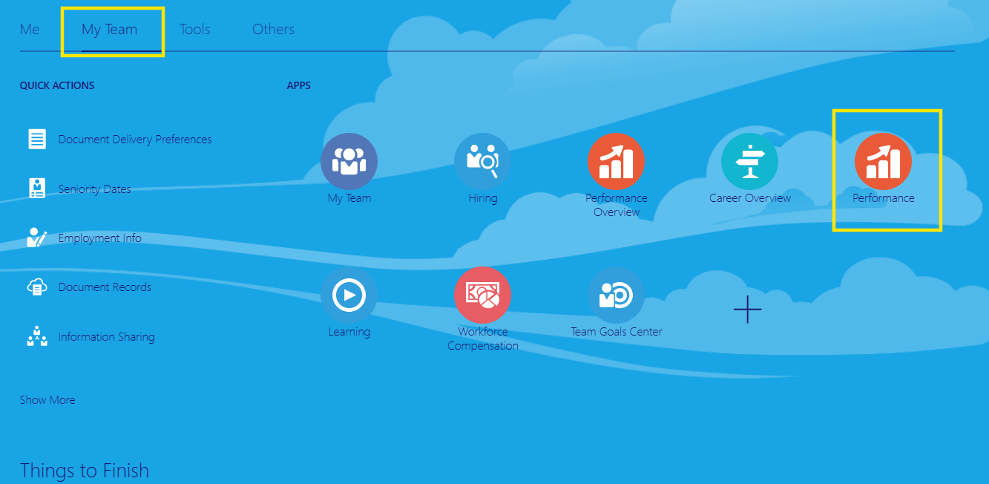
Log in to the system
My Team > Performance

Slide 8
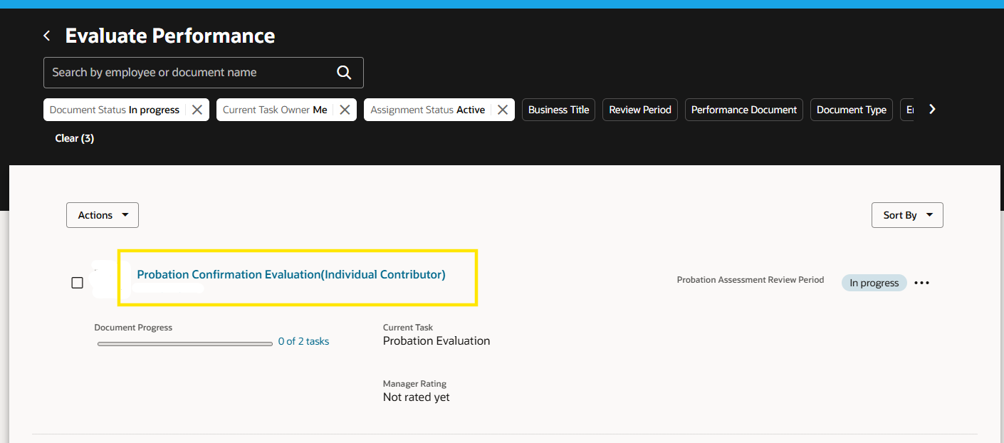
Select the Probation Document

Slide 9
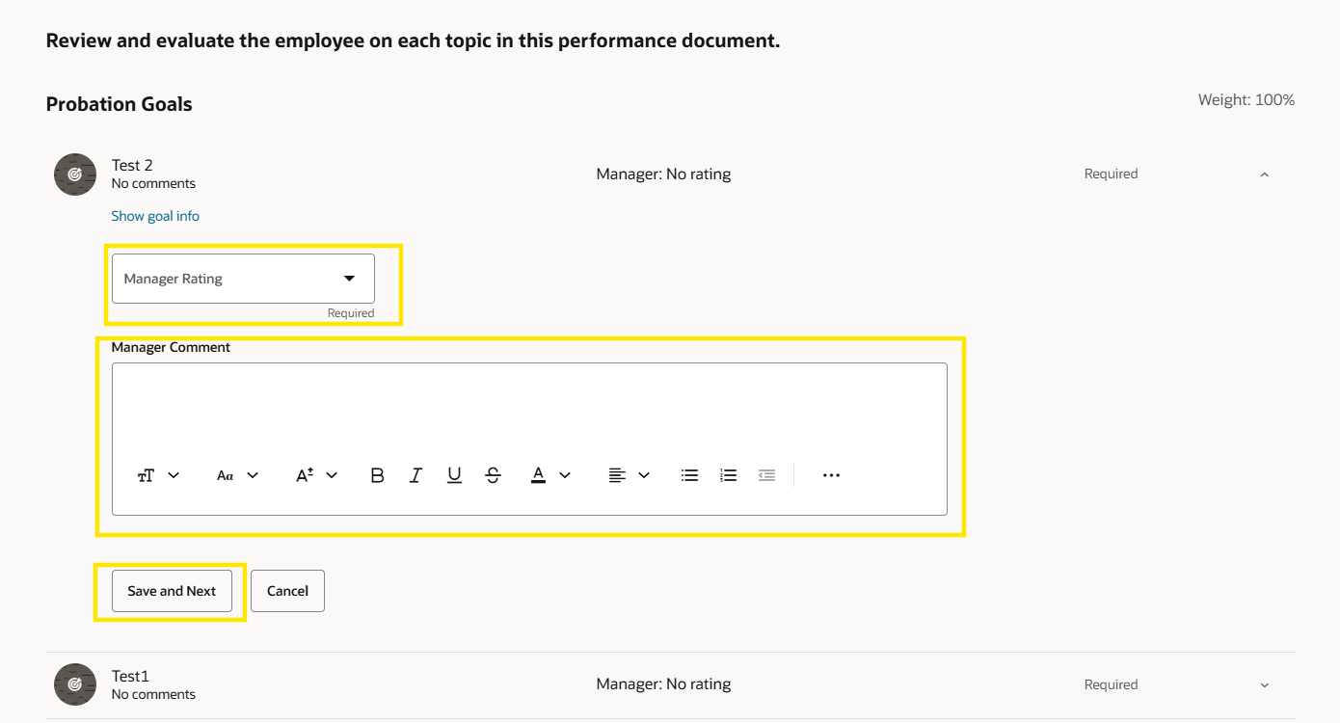
Scroll down to the Goals section and provide rating and comments in the goal and click ‘Save and Next’
Repeat the same process for all the goal items and click ‘Save and Close’

Slide 10
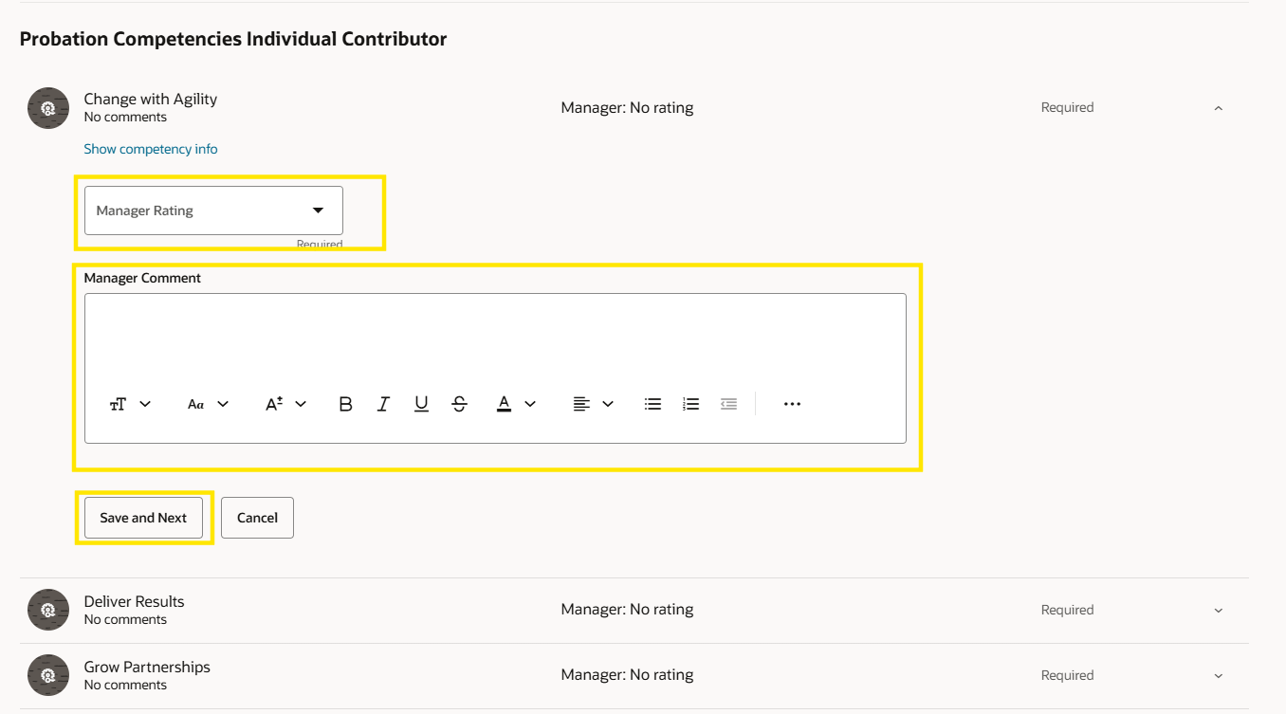
Scroll down to the Competency Section and provide rating and comments in the competency item and click ‘Save and Next’.
Repeat the same steps for all competency items and click ‘Save and Close’

Slide 11
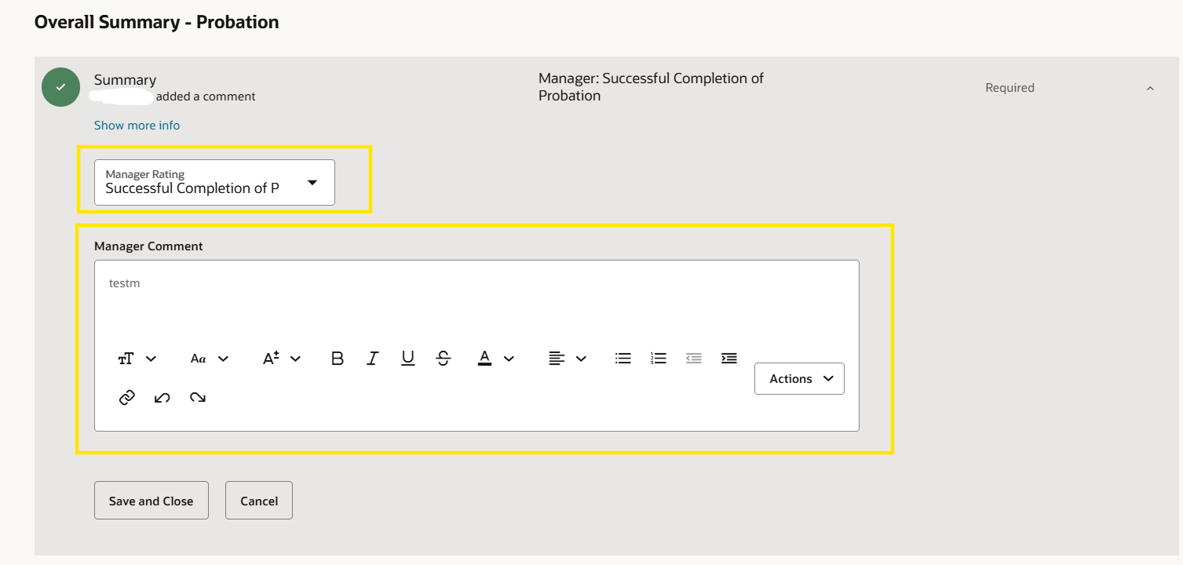
Scroll down to the Overall Summary – Probation section and provide comments and comment and click ‘Save and Close’

Slide 12
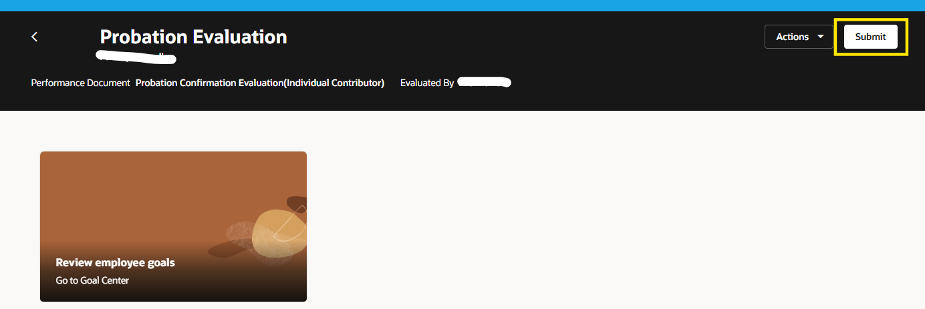
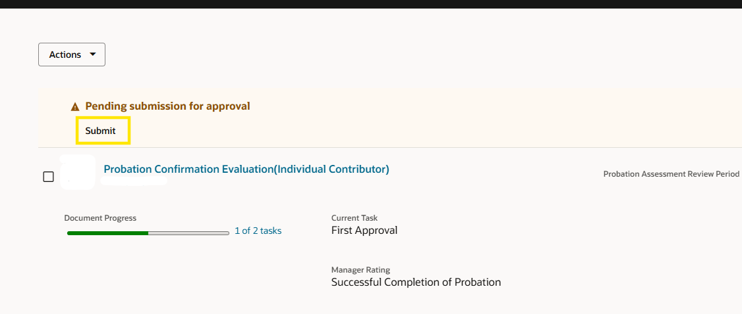
After providing all the ratings and comments click on ‘Submit’ to send for approval.

Slide 13
Reviewer Related Tasks

Slide 14
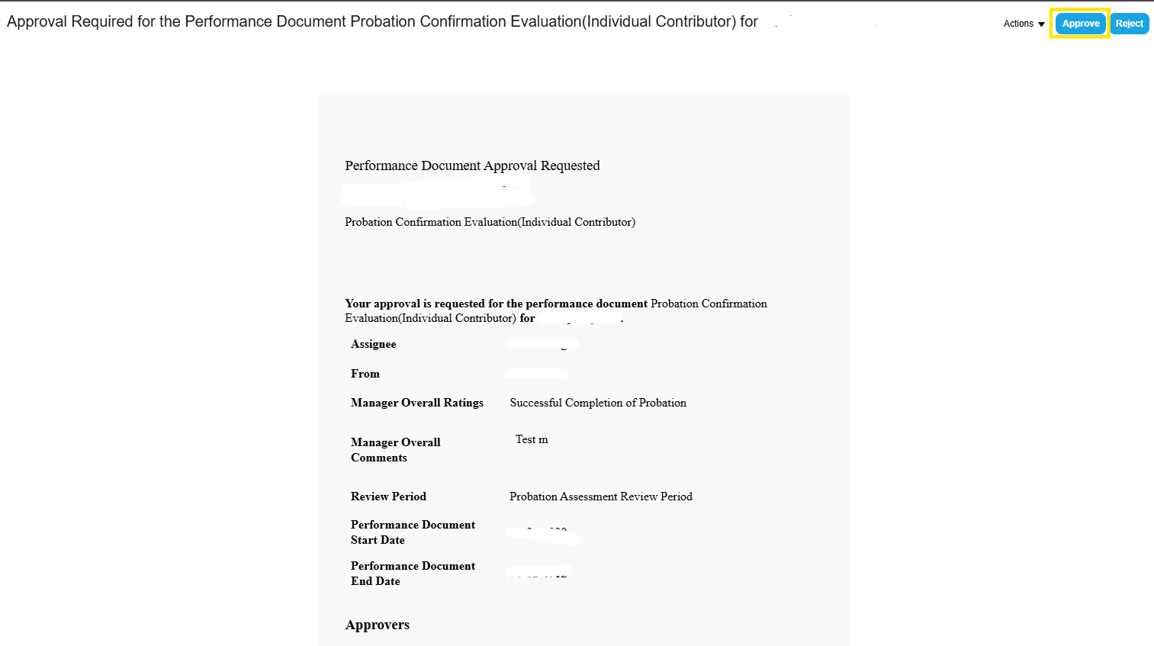
Approval by Reviewer
There are three ways to approve
1. Approving directly from the notification as shown below
2. By accessing the performance document from the notification (shown in the subsequent slides) and then approving the same
3. By accessing the performance document from My Team > Performance Overview and approving it

Slide 15
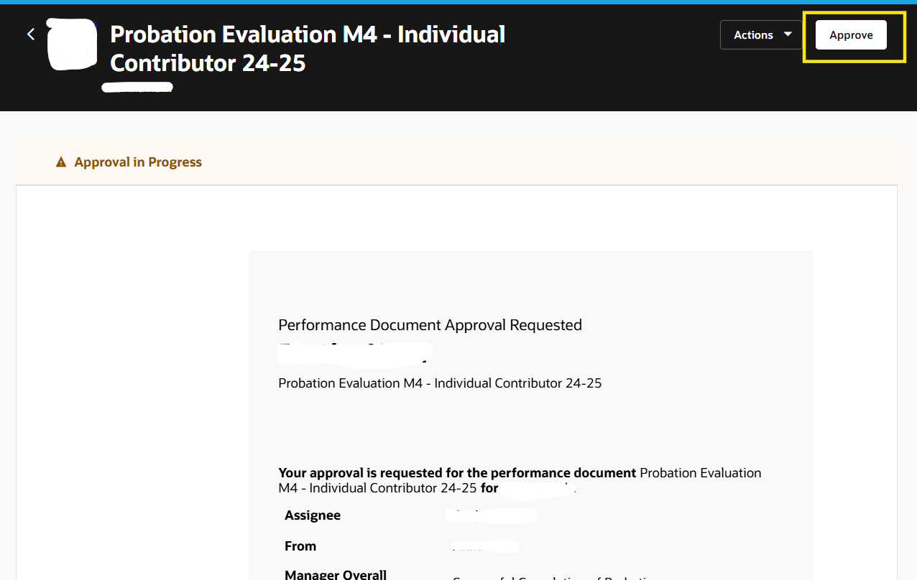
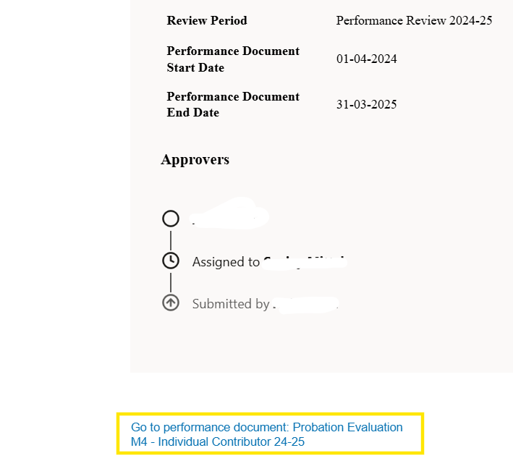
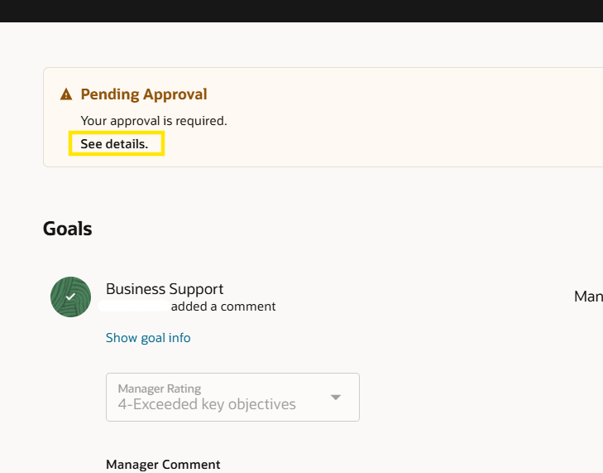
Accessing the performance document from the notification

Slide 16
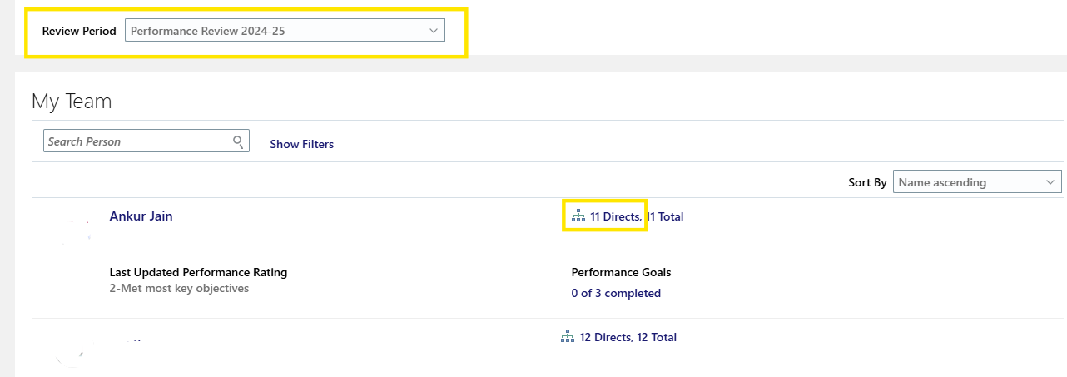
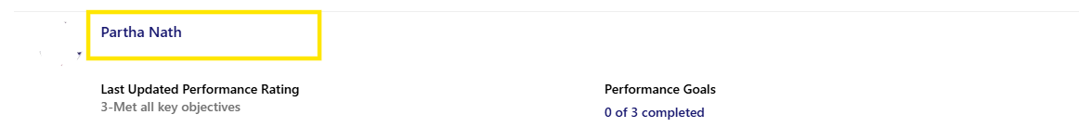
Go to My Team > Performance Overview select the review period
Click on the link highlighted in the below image right next to the employee for whom you want to list the indirect reports
Click on the employee name for whom you want to approve the document.
Line manager name
Employee Name

Slide 17
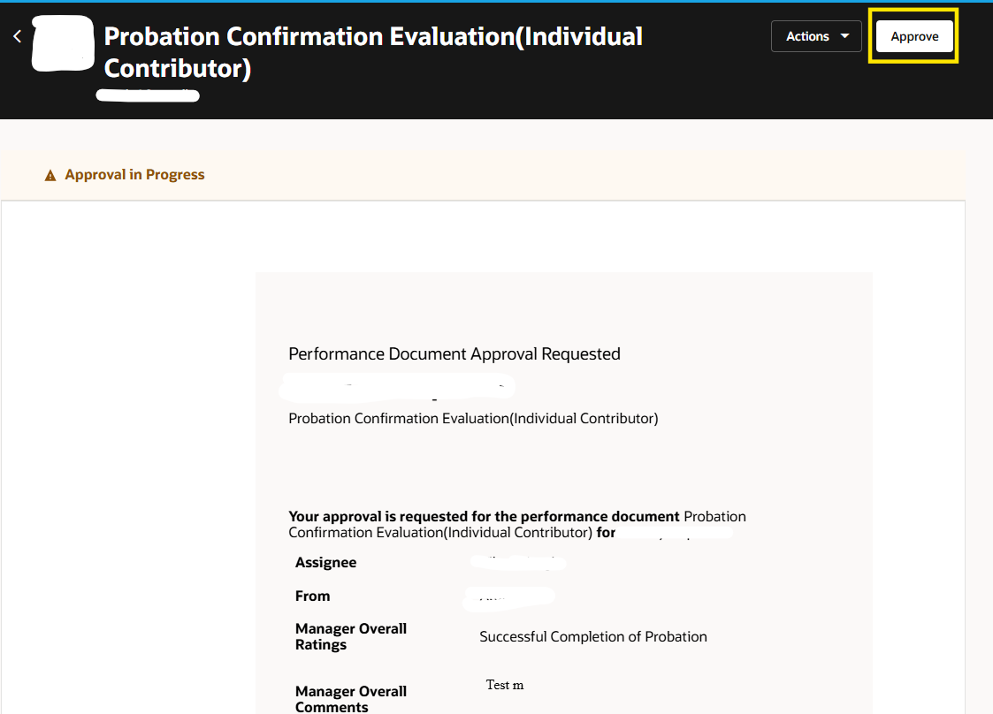
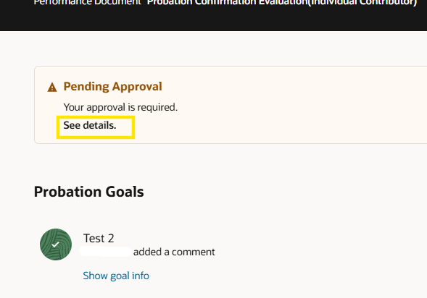
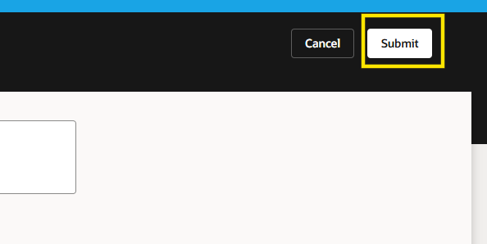
Navigate to the performance document for which your approval is pending and click ‘See details’
Then click on ‘Approve’ and then ‘Submit’

Slide 18
HR/Reviewer Approvals

Slide 19
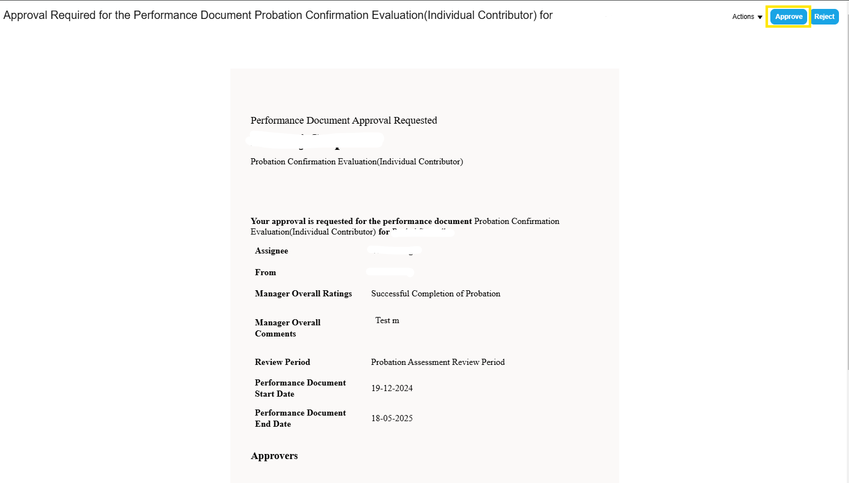
Approval by HR Spoc
There are two ways to approve
1. Approving directly from the notification as shown below
2. By accessing the performance document from the notification (shown in the subsequent slides) and then approving the same

Slide 20
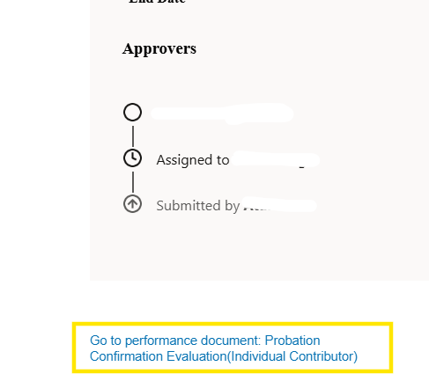
Accessing the performance document from the notification

Slide 21
Thank You

